Slide 1
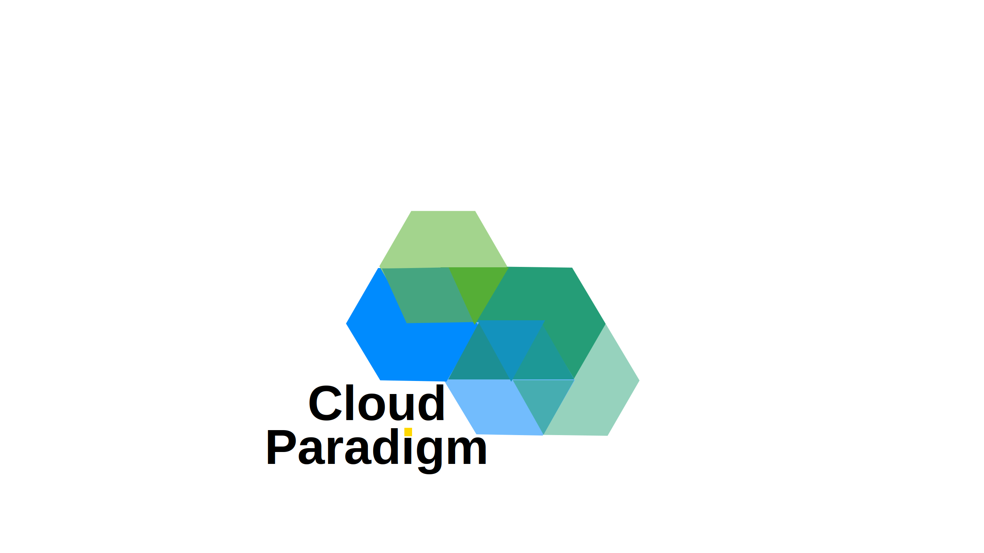
PRESENTED BY CLOUD PARADIGM PTY LTD
Infrastructure is Dead,
Long Live Infrastructure
in the Age of Agentic AI
Reid Purvs
Owner & Principal | Cloud Paradigm Pty Ltd
March 2026

Slide 2
PRESENTATION OVERVIEW
Infrastructure is Dead,
Long Live Infrastructure in the Age of Agentic AI
The rise of Agentic AI is fundamentally transforming how enterprise Azure environments are architected, designed, deployed, and managed. Traditional infrastructure practices — once reliant on manual processes and static configurations — are giving way to intelligent, autonomous systems capable of making real-time decisions at scale. By integrating Agentic AI with DevOps pipelines, organisations can achieve self-optimising architectures, accelerated deployments, and continuous operational intelligence. This presentation explores how this convergence redefines the infrastructure lifecycle — shifting engineers from reactive administrators to strategic orchestrators in an increasingly autonomous, AI-driven cloud landscape.
Agentic AI
Azure
DevOps
Enterprise Cloud
Infrastructure
Cloud Paradigm Pty Ltd | cloudparadigm.com.au

Slide 3
CONTACT
Get in Touch
Reid Purvs | Owner & Principal, Cloud Paradigm Pty Ltd
MOBILE
EMAIL
WEBSITE
+61 427 038 685
reidpurvis@cloudparadigm.com.au
www.cloudparadigm.com.au
Cloud Paradigm Pty Ltd | cloudparadigm.com.au

